Slide 1
ISIT 324 Software Testing
2020.03.11
UI Testing using Selenium

Slide 2
First things first
Don’t forget your course evaluation!
Student success day survey

Slide 3
On the Docket
What’s on the Final?
About redundant code in HW 6 (Moqs)…
Homework 7 review
UI Testing for Web Apps with Selenium
Optional homework assignment

Slide 4
What’s on the Final?
General questions from weeks 1 – 6, 9 and 10
In-depth questions from test design including:
Identifying equivalence classes
Building a decision table
Write a unit test using DataRows against an SUT provided for you
What’s NOT on the final?
Test doubles
Web automation

Slide 5
HW 7 Review

Slide 6
UI Testing
We won’t be talking about usability testing today

Slide 7

Web Automation
Scraping
Testing

Slide 8
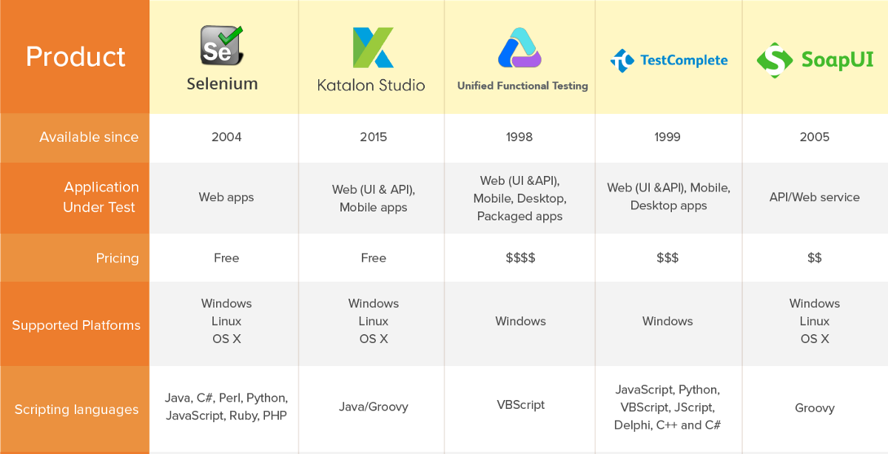

Slide 9
Disclaimer and Recommendation
Disclaimer: Full disclosure
Your intrepid instructor does not have deep front-end web development experience
Nor is your intrepid instructor a Selenium expert
Recommendation: Follow the in-class ride-along carefully
Your optional homework involves building on the example we craft in class. If you don’t have it in hand, you’ll have to start from the beginning.

Slide 10
DriveBCWebsite from console

Slide 11
The Plan
Note: We’ll use Chrome to display the site and Chrome-specific libraries to automate
Drive interaction with the Bellevue College website

Slide 12
Ride-along: Puppet Master of Bellevue College
Navigate and report info about which pages are visited
Open the BC home page
Click on the Classes link
Select Winter Quarter 2020
Search for “ISIT 324”
Click on search result and go to ISIT 324 detail page
Navigate to Final Exam schedule
Take a screen shot and save it
Hit the Back button

Slide 13
Setting up
Note: We’ll use Chrome to display the site and Chrome-specific libraries to automate
Build a console app
Add these NuGet Packages
Selenium.WebDriver: Use “Latest stable”, not “latest prerelease”
Selenium.Chrome.WebDriver (NOT Selenium.WebDriver.ChromeDriver)
Selenium.Support: Use “Latest stable”, not “latest prerelease”
Add using statements for the newly-added assemblies
using OpenQA.Selenium;
using OpenQA.Selenium.Chrome;
using OpenQA.Selenium.Support.UI;

Slide 14
The general shape of things
The web driver itself is an instance of IWebDriver with a Chrome-specific implementation:
IWebDriver driver = new ChromeDriver();
Ask the driver to get to the page you want to start driving from with its Navigate() method:
driver.Navigate().GoToUrl("https://www.bellevuecollege.edu/");
Close down at the end of the session
driver.Quit();

Slide 15
The general shape of things
Locate stuff on the page by using its FindElement() method:
IWebElement ele = aDriver.FindElement(By.Id("title"));
…or class name or CSS selector or Xpath or…
Lots of actions/properties: Text, Click(), SendText(), etc.
How to find an element? In Chrome use Inspect:
In the browser, right-click the element you want to be able to find
Select Inspect from the context menu
The tag for the element is (usually) highlighted
For the CSS selector, right click the element and copy it: on the context menu Copy/Copy selector

Slide 16
Ride-along: Puppet Master of Bellevue College
Navigate and report info about which pages are visited
Open the BC home page
Click on the Classes link
Select Winter Quarter 2020
Search for “ISIT 324”
Click on search result and go to ISIT 324 detail page
Navigate to Final Exam schedule
Take a screen shot and save it
Hit the Back button

Slide 17
Build the Page Object Model

Slide 18
Artist’s Conception
Home page
Page 1
Page 2
HTML
HomePage
Page1
Page2
Classes
Test1
Test2
Test3
Test4
Unit Tests

Slide 19
Shape of a Page Object Model
Set up a static Driver class
One class per page
Properties: One private property per element you want to access
Methods:
Get method for every element you need to access
Action method for any Selenium methods you need to call
Some developers like to split out:
Page definitions (properties only)
Navigation
Actions
Note: Many online resources use the PageFactory class. It’s been deprecated. Try not to use it.

Slide 20
Ride-along: Objectify the earlier Ride-Along
First as a Console App
Navigate and report info about which pages are visited
Open the BC home page
Click on the Classes link
Select Winter Quarter 2019
Search for “ISIT 324”
Click on search result and go to ISIT 324 detail page
Navigate to Final Exam schedule
Take a screen shot and save it
Hit the Back button

Slide 21
Ride-along: Add Some Unit Tests
Use FluentAssertions. Good at handling objects.
Tests we’ll add:
Click on Classes, make sure you end up there
Click on Programs, make sure you end up there
Click on Classes, go back, click on Programs, go back, and make sure you visited both pages
Search from common search box, make sure you get the correct result

Slide 22
Homework will be available tomorrow

